Slide 1
AmeriCorps Advantage: Facilitator’s Handbook Overview
Andrea Weiss, MS, NCC, MCC
Career Counselor & Executive Recruiter

Slide 2
Notes:
Would you like this occupation exercise.

Slide 3
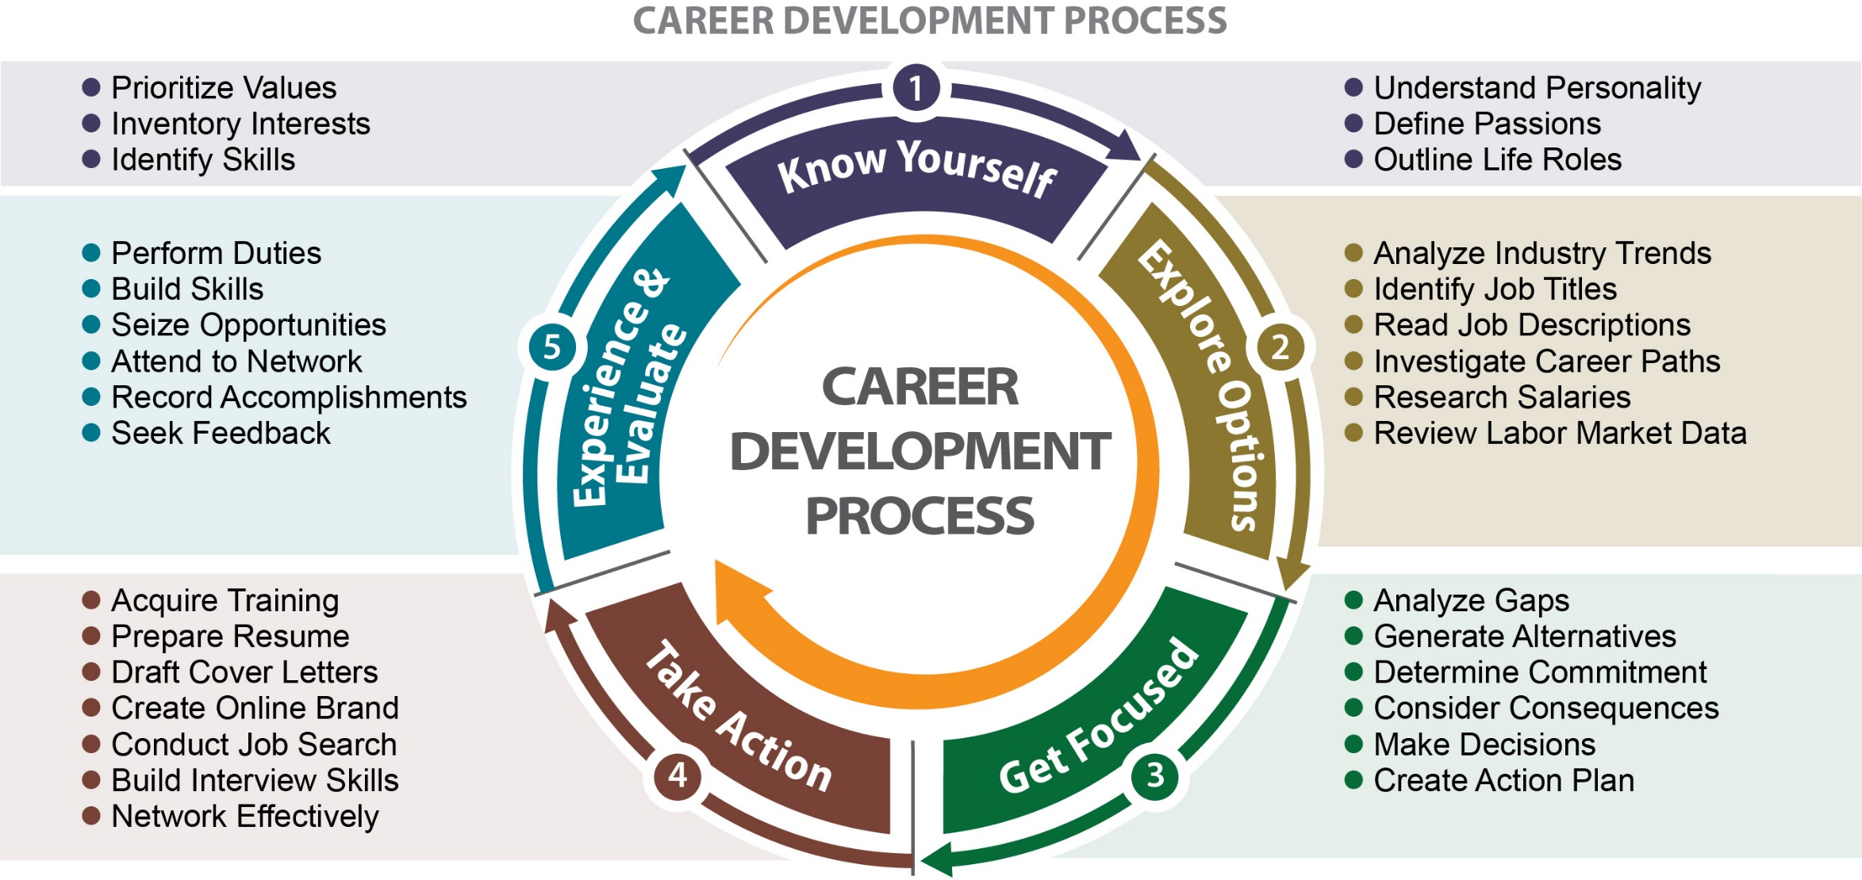

Slide 4
How to Use Facilitator’s Handbook
Your Role
Tour Guide, Resource, Sounding Board
Customize
Provide Foundation for Lifelong Process
Notes:
No need to be an expert in career development or job search; call on others for help
Customize: Meet members where they are in the process. If working with a larger group, divide by stage in the process / interest area / create affinity groups
Times are approximate - shorten or extend as needed by your members
Providing foundation – members won’t have all the answers and our career development unfolds and our career goals change over our lives

Slide 5
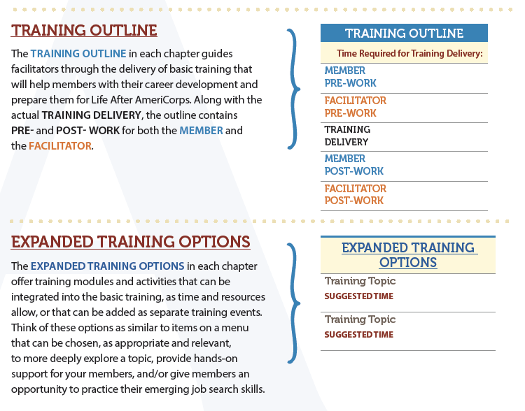
Chapter Contents

Slide 6
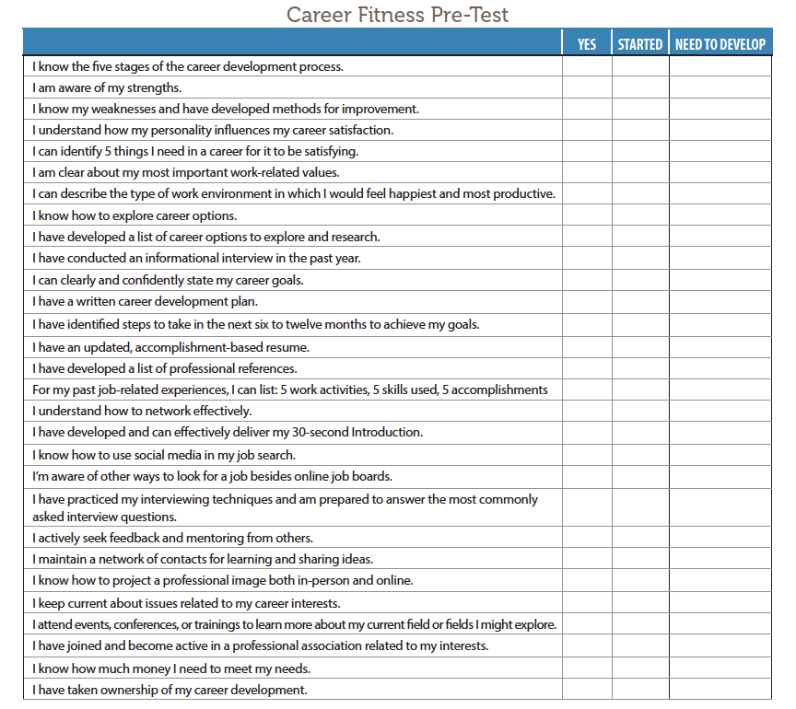
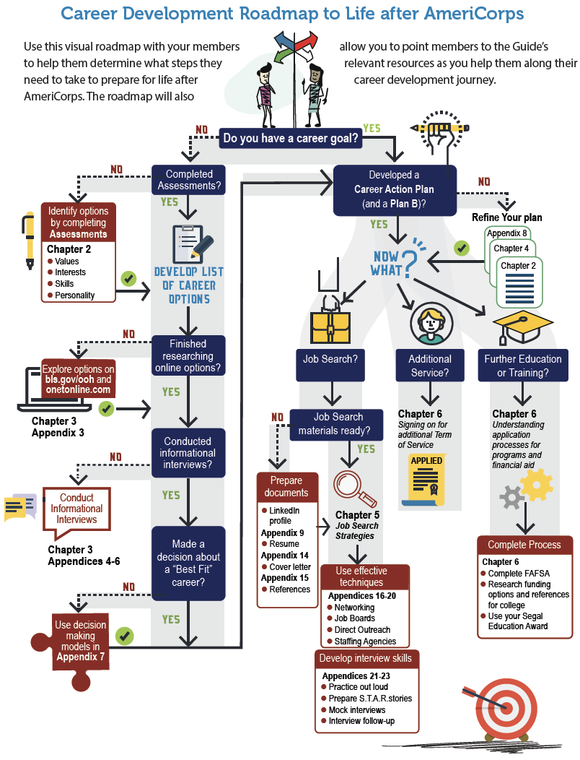
Getting Started

Slide 7
Fun Activities
Dream Job Mad Lib
Handshake Practice
Baker Tree(s) of Options Round Robin
Elevator Pitch Video: https://www.youtube.com/watch?v=uyxfERV5ttY
Bragging Practice
Career Serendipity
Goofus & Gallant Interviews
Jobpardy

Slide 8
IDEA SHARING
Capture Ideas
Share the Best

Slide 9
Planned Resources
Digital versions of Guide and Handbook
Online Idea Sharing (Basecamp)
PPT Template
Training Funds

Slide 10
Q & A

Slide 11
Review
Know: What was shared today that confirmed what you already knew?
Challenge: What is something new you learned today that you need to add to your training?
Change: What is one way you plan to change your approach based on today’s training?
Feel: How do you feel about what you learned today?

Slide 12
AmeriCorps Advantage: Facilitator’s Handbook Overview
Andrea Weiss, MS, NCC, MCC
Career Counselor & Executive Recruiter

