Slide 1




Welcome to the New Program Year!
AmeriCorps Advantage: CaliforniaVolunteers Grantee Training Conference, July 2017
Notes:
We will be sending this out after the call, including the notes for each slide, so don’t worry about getting everything in your notetaking.

Slide 2
Service Opportunity Listings
As of July 2, 2018, all grantees are required to post all service opportunities in the MyAmeriCorps Portal.
For most programs this is just one or two postings (one for each position type offered)
Find instructions for completing listings on the AmeriCorps Knowledge Network:
  www.nationalservice.gov/resources/americorps/member-assignment-listings
Notes:
While you must post the opportunities on the portal, you only do one for each POSITION TYPE offered. Since posting these on the MyAmeriCorps portal is a new requirement, CNCS is taking longer to approve these than under normal circumstances. If you need to have members apply via your internal process, you may still do so and you can still invite members to enroll without them having applied via the portal.

Slide 3
The 2018 Multi-Step Enrollment Process
This year there are several NEW steps to the enrollment process which need to be done ahead of the final step of enrolling the member – it’s best to start EARLY
To ensure grantee understanding of all the steps of the new process, CV has adapted the CNCS Presentation provided on 6.28.18
Notes:
In addition to the 30-day window to enroll members changing to 5 days, the process now has several new components that MUST be completed well ahead of the member starting.

Slide 4
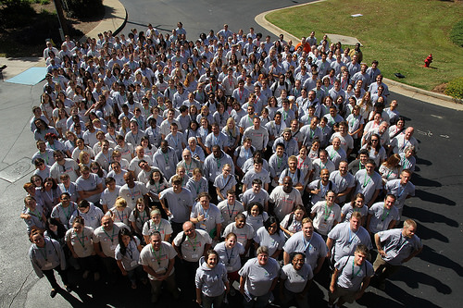
Purpose
The following presentation will guide AmeriCorps program users through the AmeriCorps member enrollment process in the MyAmeriCorps Portal.
This presentation represents grantee requirements for enrolling members in the Portal as of July 2, 2018.

Slide 5


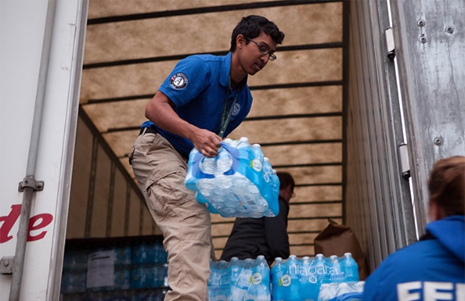
Important Considerations
This presentation focuses on the functionality of the MyAmeriCorps/egrants member management system.
Programs must conduct screening of prospective members as part of the recruitment and selection process and VALIDATE having done so in egrants.
The screening must include validation:
  Citizenship eligibility
  A national sex offender public website check prior to selecting the applicant
  State/FBI checks
Notes:
While programs have previously been required to do this screening and provide copies of these in the member file, this has now also been incorporated into the egrants/MyAmeriCorps member management system (portal).

Slide 6
Member Enrollment Basic Rules
Steps to conduct PRIOR to MemberSTART
Verification of SSN validity and citizenship eligibility automatically (or later manually) in Portal when member accepts invitation
2. Before AmeriCorps member’s first day of service:
  Complete NSOPW
  Initiate State/FBI background checks (California requires all checks are CLEARED prior to member start)
  In portal, verify these steps are completed and hit SAVE!
3. Certify member enrollment no later than 5th calendar day from member’s start
Final Step: within 5 calendar days of start

Slide 7
STEP 1: Invitation and Member Acceptance
Program sends invitations to serve in AmeriCorps to prospective members.
Notes:
The first step in enrolling members starts with Inviting them to begin their part of the process. [READ SLIDE]

Slide 8
What Programs See: Invite Members
Enter applicant’s data and select the program, grant year, and service location from the drop-down lists.
Click on add another to send the current invitation and enter another.
Click on save to send one invitation and return to your home page.
Notes:
You invite members to enroll just like in the past. To create an invitation, you’ll need to enter – the potential member’s name, social security number, DOB and email. Be EXTRA CAREFUL entering these as any error could cause later problems. When you hit ‘save’ the system will generate an invitation that will go directly to the member at the email that you entered.

Slide 9
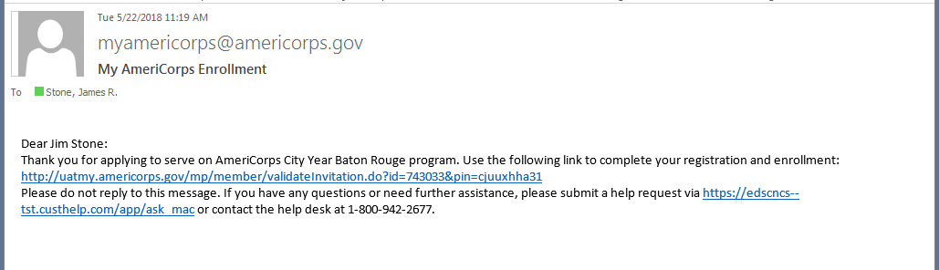
What will applicants see?
Text of invitation to serve message:
This is a unique link for each applicant.
Notes:
Each member gets this exact message via email from the egrants system. When the member clicks on their unique link, they will be taken to egrants to begin their part of enrollment.

Slide 10
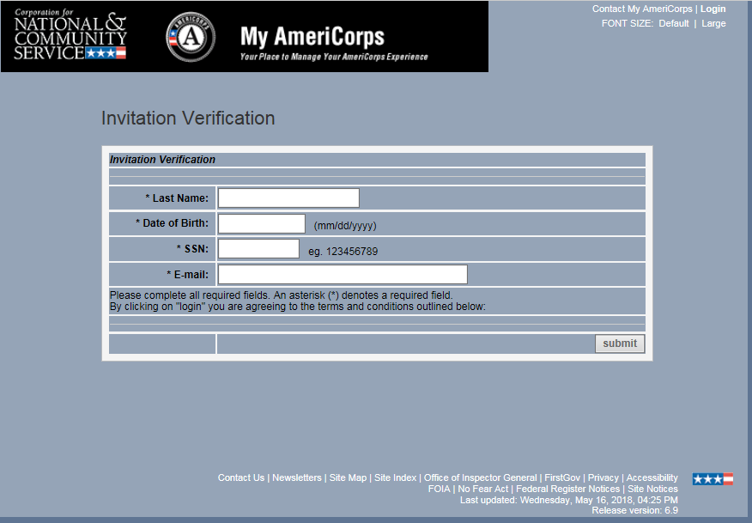
What will applicants see?
Applicant screen from invitation email:
Notes:
They then enter their name, DOB , SSN and email address. When they hit ‘submit’, their SSN is immediately sent to SSA to verify their social security number and citizenship.

Slide 11
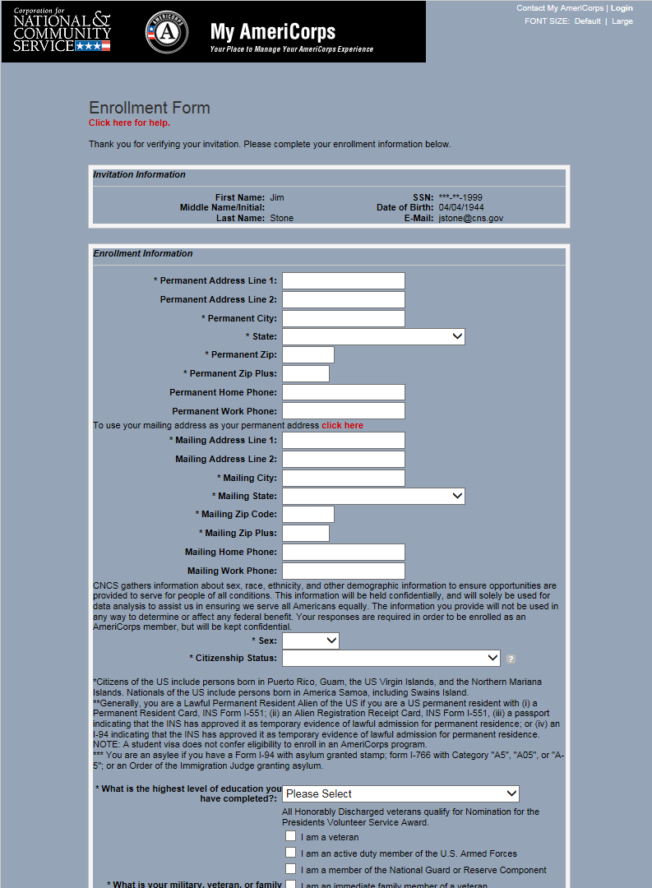
What will applicants see?
Member
Enrollment
Form
Notes:
Next they will complete additional information screens and the remainder of their part of enrollment.

Slide 12
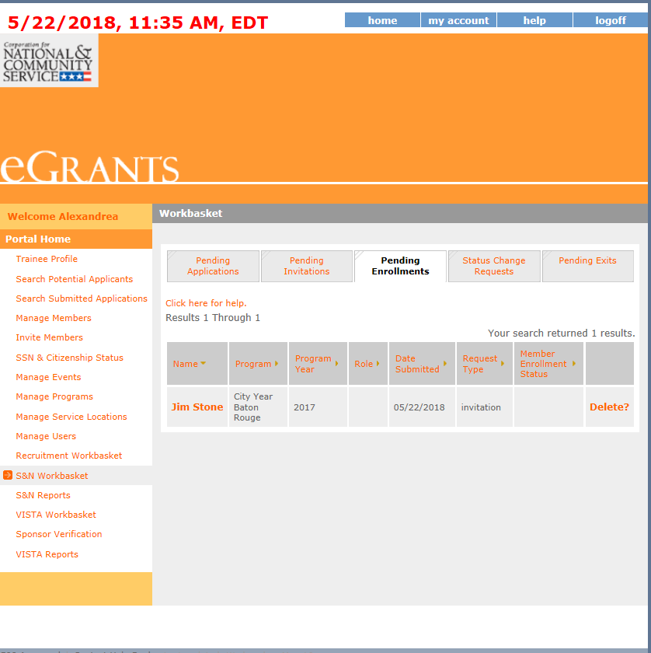
What Programs See:
Pending Enrollment Workbasket
Programs will see a list of individuals who have accepted their invitations to serve
Notes:
Once the member completes their part of enrollment and hits ‘save, they should appear in Pending Enrollments in your Workbasket.

Slide 13
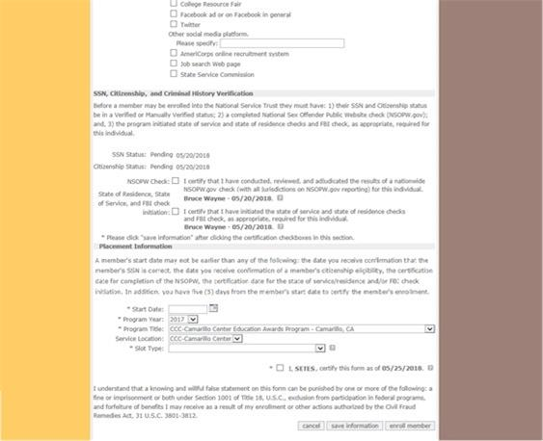
Step 2 -- New Section:
SSN and Citizenship Verification
This is a new section of the enrollment form; programs will see the SSN and citizenship verification status. In this example, both are pending. This means the member’s information is being verified by SSA.
Notes:
When you click on a member name in the Pending Enrollments, you’ll see this new section. Again, once the potential member completed their part of enrollment, it immediately sent their info to Social Security Administration for validation. They status of that validation will show up in this section as either ‘pending’ or if it happens quickly, ‘verified’ or possibly, ‘returned’. You will have to continue to check here to see if it’s been verified – unfortunately, you won’t receive any separate notification.
Note there is a field for SSN and a field for Citizenship. If either or both show ‘returned’ you’ll need to submit those documents to the help desk (we will discuss that process in more detail later) . If additional documentation is sufficient to verify eligibility, then CNCS staff will manually update the Portal record and the enrollment process will continue. You’ll need to check the portal and look for a status update to ‘manually verified’. Again, you won’t receive other notification. If the additional documentation you submitted to the helpdesk is not sufficient, the program will be notified, and the member cannot be enrolled.

Slide 14
SSN and Citizenship Verification
The Portal will submit the record to the Social Security Administration (SSA) as soon as the member completes and saves her section of the enrollment form.
By the morning of the next business day, the record will indicate “Verified” or, if not verified, “Returned” in the Portal:
  If verified by SSA, then the enrollment process will proceed to the next step.
  If not verified by SSA, then the program will collect additional documentation and submit it to the CNCS hotline.
    If additional documentation is sufficient to verify eligibility, then CNCS staff will manually update the Portal record and the enrollment process will continue.
    If the additional documentation is not sufficient, the program will be notified, and the member cannot be enrolled.

Slide 15
Step 3: CHC Verification – MUST be done before the member START date
Programs will verify the NSOPW is complete and that State/FBI checks are initiated, per CNCS requirements. In California, they should have CLEARED for you to check these boxes.
Be sure to select ‘Save Information’ after entering the requested information. This MUST be done before the member’s START date. There is a time stamp that will be generated with this date.
Notes:
The next section to complete is verification of Criminal History Checks. You are not yet ENROLLING the member, you are just verifying having completed Criminal History Checks. After checking each box, indicating this, when you hit SAVE INFORMATION that day’s date, along with your name, will appear next to each criminal history check. You MUST complete this step BEFORE the member’s start date. The system will not allow you to later enter a START date that occurs before the date you completed this step.
It is also important to note that the dates that will appear next to each Criminal History Check box (which will be the date you do this step) are not the same as the actual CHC Clearance Dates. CV will still refer to the member’s CV NSCHC Verification form to validate the dates each check was cleared in our file reviews.

Slide 16
Final Step: Enter Placement Information & Enroll member!
The text for this section of the enrollment form is new; programs will enter placement information prior to enrolling the member. California requires ALL CHECKS are CLEARED to do this final step!
Notes:
Everything up to this point was really pre-enrollment! Now, once the SSN & Citizenship are showing ‘verified’ or ‘manually verified’ and the CHC are all CLEARED and you’ve certified that in the portal, the ENROLL MEMBER button will finally be ACTIVATED. Then, just like in the past you:
Enter member start date
Enter service location
Enter slot type
Check Certification box
Hit Enroll Member (do not hit this button until all checks are cleared) location. The final step has to be done within 5 calendar days of the member starting (with their start date as DAY 1):
Again, in California, the start date you enter CANNOT be before ALL Criminal History Checks have CLEARED. Good practice would be to cross check the member’s NSCHC Verification Form and look at the clearance dates to ensure you are entering a start date that is after CLEARANCE OF ALL CHECKS. CV will cross check the start date against those dates during file reviews. Those are also the dates you’ll note in your CHC Tracker Form for submittal to CV.

Slide 17
Member Enrollment Workflow—START EARLY!
1. Service opportunity
All opportunities types are required to be posted on the My AmeriCorps Portal, (but members can still apply outside the system if needed).
2. Invitation and Acceptance
Once applications are reviewed, programs create and send an invitation to enroll to prospective members from the egrants workbasket
3. SSN/Citizenship Verification
Invited member records go to the Social Security Administration to verify SSNs and citizenship (check portal regularly for updates)
4. CHC Verification
Programs complete Criminal History Check Verification portion of the enrollment form in egrants BEFORE THE START DATE. In California ALL CHC CHECKS SHOULD BE CLEARED to do this step.
5. Start Date and Service Location
Programs collect verification documentation from invited members. If verification is not received from SSA this will be submitted to the CNCS Hotline. CV requires this information be placed in Member File for later review either way.
After SSN/Citizenship and CHC Verification are complete, you can now complete FINAL STEP by entering member’s service site, certifying, then hit ENROLL MEMBER. In California ALL CHC CHECKS MUST BE CLEARED to do this step. Cross check CV NSCHC Verification Form to ensure start date you enter is after all CHC checks are cleared. Members must be enrolled within 5 calendar days of their START date (start date counts as Day #1).
Invited members receive the system-generated email, and complete Part 1 of the enrollment form in the portal (SSN goes straight to SSA for verification)
Notes:
To review the steps again [READ SLIDE]
Note that the Start date counts as Day 1, and the rule is 5 Calendar days, so weekends are included!

Slide 18
Additional Tips
SSN Documentation Submittal Process:
Help desk via phone or chat is best
Request a Secure File Transfer Link from CNCS.
Request a help desk ticket # at the same time
When submitting the documents, title the file name “Pending Enrollment”
Since there is no NSPID# include: First/Last Name, date of birth, email, and the Grant ID number.
Check member status daily, until you see ‘Manually Verified’
Do not request a new help desk ticket # or resubmit documents, per CNCS instructions.
Notes:
[KM] Contacting the help desk via phone or chat is the best method as the webform request has been having trouble. Request a Secure File Transfer Link from CNCS. When you request the link, request a help desk ticket # at the same time. This is vital for checking on the status of the member, if there is a delay.
When submitting the documents, title the file name “Pending Enrollment” to expedite processing. This will move the member to the front of the line (rather than with the other eligibility items from this summer).
In the past, you have included the member’s NSPID# in the manual verification process. Since the member is not enrolled, they will not have an NSPID#. Instead, document on the form: First/Last Name, date of birth, email, and the Grant ID number.
Check the status of the member daily, until you see that their status has changed to ‘Manually Verified’
Do not request a new help desk ticket # or resubmit documents, per CNCS instructions.
Again, email communication seems to have the longest response time; phone or chat function seem to work better, currently.

Slide 19
Resources
Your Program Officer
CNCS hotline:
  1-800-942-2677
  https://questions.nationalservice.gov
Instructions for creating member service opportunities:
  www.nationalservice.gov/resources/americorps/member-assignment-listings
Notes:
CV is very interested in hearing about your experience with the Pre-Enrollment process. Please reach out to your Program Officer with any concerns or questions. We will be tracking this process carefully, and providing feedback to CNCS if there are technical issues.

Slide 20
Questions?
Q & A

Slide 21
Survey
We’ll send this ppt out via email after the webinar
Please take the remaining 5 minutes to complete the survey that will appear immediately following the webinar from Go2Webinar . . .
We really want your input for out Training Plan for 18-19!

